Slide 1
ORBITAL CAVITY
BY
Dr. F.O. OPOOLA

Slide 2
LEARNING OBJECTIVES
INTRODUCTION
LOCATIONS
BORDERS AND ANATOMICAL RELATIONS
BOUNDARIES
CONTENT
PATHWAY INTO THE ORBIT
FUNCTIONS
CLINICAL ANATOMY

Slide 3
INTRODUCTION
The orbital cavity, also known as the orbit, is a bony socket located within the skull that houses and protects the eye and its associated structures.
It is an important and complex structure in the human body, playing a vital role in vision and eye movement.
The bony orbits (or eye sockets) are bilateral and symmetrical cavities in the head. They enclose the eyeball and its associated structures.

Slide 4
Location
The orbital cavities are located within the skull, one on each side of the head. They are situated in the frontal bone, just above the nasal cavity and below the frontal lobe of the brain.
The orbital cavities are separated by a thin partition of bone called the septum orbitale.
They are located in a strategic position within the skull, providing protection and support for the eye and its associated structures.
The bones of the orbital cavity are thick and strong, helping to shield the eye from mechanical trauma and injury.

Slide 5
DIVISION OF THE ORIBAL CAVITY
It is divided into two parts: the anterior and posterior orbital cavities.
The anterior orbital cavity is the larger of the two and contains the eyeball, extrinsic eye muscles, and the lacrimal gland.
The posterior orbital cavity is smaller and contains the optic nerve, oculomotor nerve, and the levator palpebrae superioris muscle.
The orbital cavity is lined with a thin, vascular membrane called the orbital periosteum, which helps to nourish the structures within the orbit and protect them from mechanical trauma.
The orbital periosteum is richly supplied with blood vessels and nerve endings, making it highly sensitive to touch and pressure.

Slide 6
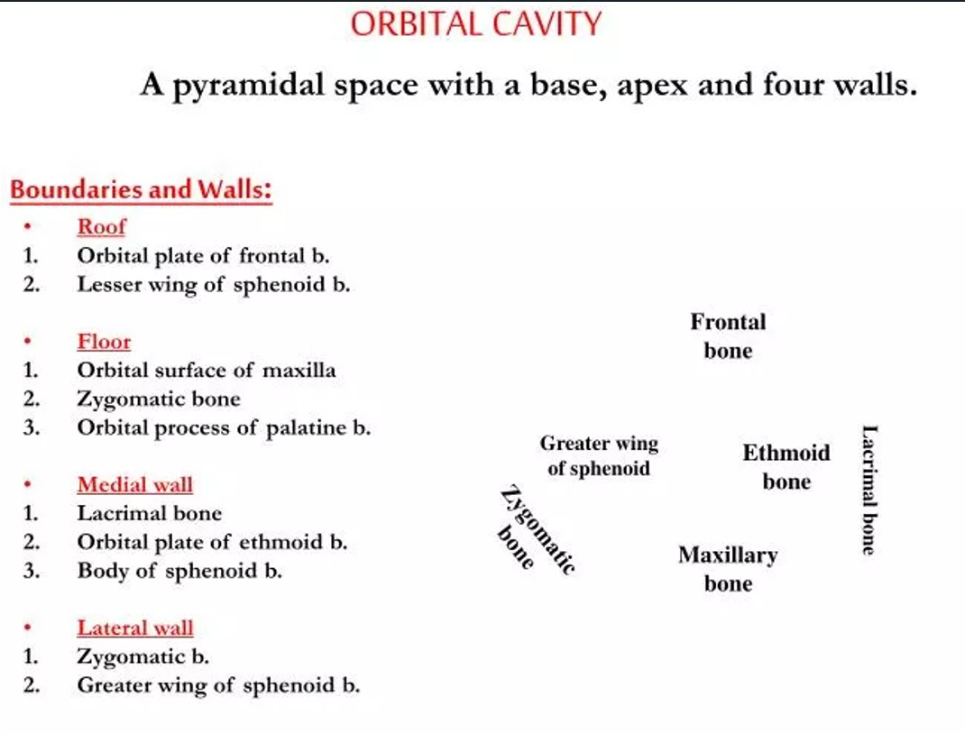

Slide 7
The borders and anatomical relations of the bony orbit are as follows:
Roof (superior wall) – Formed by the frontal bone and the lesser wing of the sphenoid. The frontal bone separates the orbit from the anterior cranial fossa.
Floor (inferior wall) – Formed by the maxilla, palatine and zygomatic bones. The maxilla separates the orbit from the underlying maxillary sinus.
Medial wall – Formed by the ethmoid, maxilla, lacrimal and sphenoid bones. The ethmoid bone separates the orbit from the ethmoid sinus.
Lateral wall – Formed by the zygomatic bone and greater wing of the sphenoid.
Apex – Located at the opening to the optic canal, the optic foramen.
Base – Opens out into the face, and is bounded by the eyelids. It is also known as the orbital rim.

Slide 8
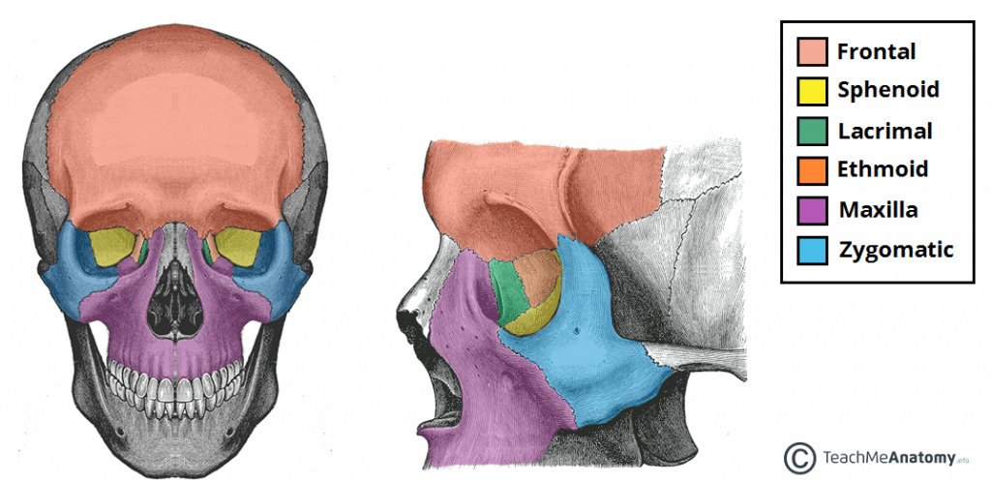

Slide 9
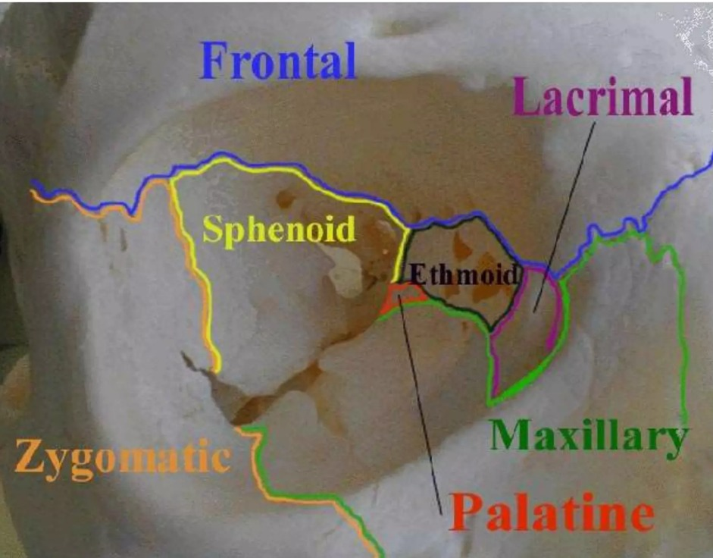

Slide 10
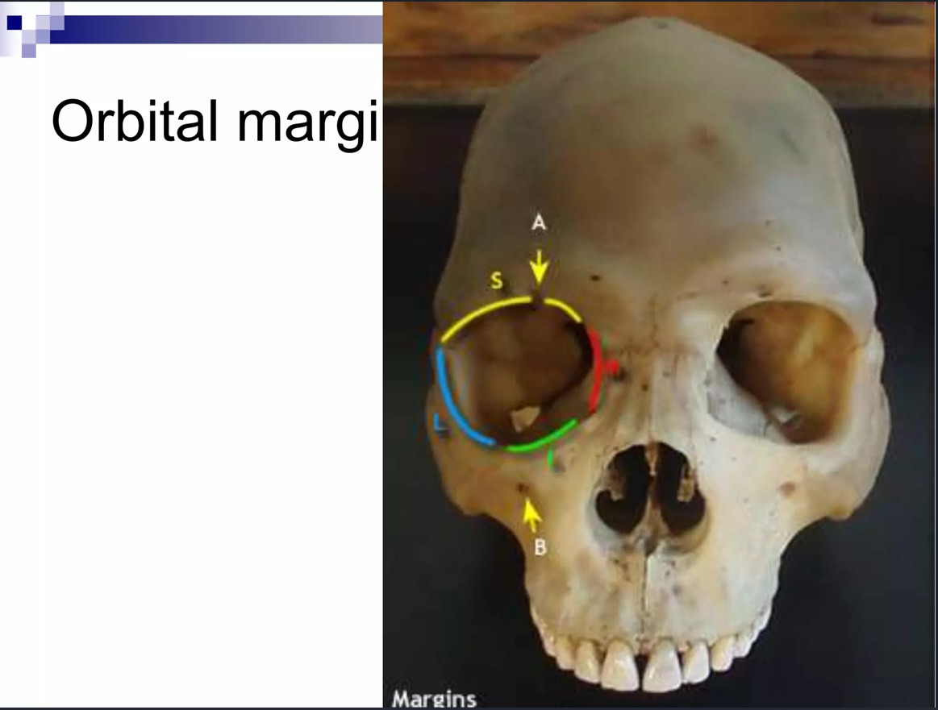

Slide 11
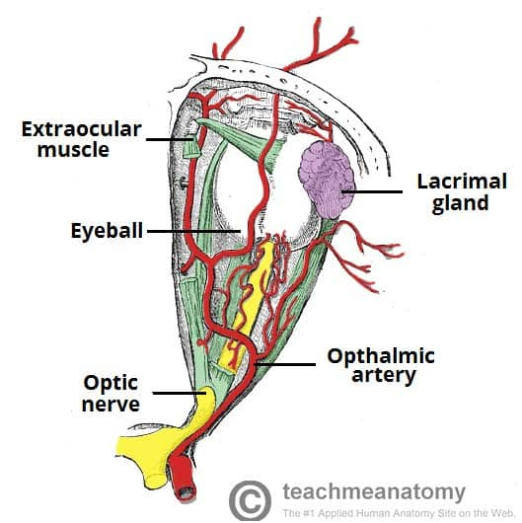
CONTENTS
2024)
The bonyorbit contains the eyeballs and their associated structures
Extra-ocular muscles – These muscles are separate from the eye. They are responsible for the movement of the eyeball and superior eyelid.
Eyelids – These cover the orbits anteriorly.
Nerves: Several cranial nerves supply the eye and its structures; optic, oculomotor, trochlear, trigeminal and abducens nerves.
Blood vessels: The eye receives blood primarily from the ophthalmic artery. Venous drainage is via the superior and inferior ophthalmic veins.
Any space within the orbit that is not occupied is filled with orbital fat. This tissue cushions the eye, and stabilises the extraocular muscles.
Diagram of the arterial supply to the eye.

Slide 12
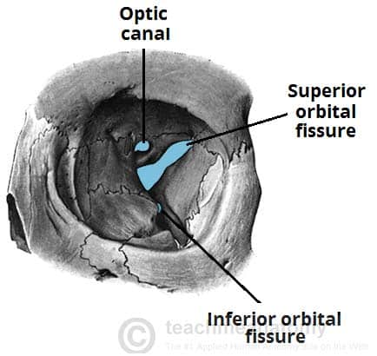
Pathways into the Orbit
There are three main pathways by which structures can enter and leave the orbit:
Optic canal – transmits the optic nerve and ophthalmic artery.
Superior orbital fissure – transmits the lacrimal, frontal, trochlear (CN IV), oculomotor (CN III), nasociliary and abducens (CN VI) nerves. It also carries the superior ophthalmic vein.
Inferior orbital fissure – transmits the zygomatic branch of the maxillary nerve, the inferior ophthalmic vein, and sympathetic nerves.
There are other minor openings into the orbital cavity. The nasolacrimal canal, which drains tears from the eye to the nasal cavity, is located on the medial wall of the orbit. Other small openings include the supraorbital foramen and infraorbital canal – they carry small neurovascular structures
The major openings into the orbit.

Slide 13
Function
The main function of the orbital cavity is to house and protect the eye and its associated structures.
The orbital cavity provides a stable and supportive environment for the eye, allowing it to move and function properly.
The orbital cavity also plays a vital role in vision. The eye is able to move within the orbital cavity, allowing it to focus on objects at different distances.
The extrinsic eye muscles, which are located within the orbital cavity, are responsible for controlling the movement of the eye. These muscles are innervated by cranial nerves III, IV, and VI, which are responsible for controlling eye movement.
The orbital cavity is also home to the lacrimal gland, which is responsible for producing tears. Tears are necessary for maintaining the health of the eye, as they help to moisturize and protect the surface of the eye from debris and foreign particles.

Slide 14
Clinical Significance
The orbital cavity is susceptible to a variety of disorders and conditions that can affect the eye and its associated structures. Some of the more common disorders that can affect the orbital cavity include orbital cellulitis, orbital fractures, and orbital tumors.
Orbital cellulitis
Orbital cellulitis is a serious infection that affects the tissues of the orbital cavity. It is typically caused by bacteria that enter the orbit through the sinuses or the eye. Symptoms of orbital cellulitis include redness and swelling of the eye, fever, and eye pain. Treatment usually involves antibiotics and, in severe cases, hospitalization.
Orbital fractures
Orbital fractures are breaks or cracks in the bones of the orbital cavity. They can be caused by trauma, such as a blow to the head or an automobile accident. Symptoms of an orbital fracture may include double vision, eye pain, and swelling around the eye. Treatment may involve the use of medications to control inflammation and swelling, and surgery may be necessary to repair the fracture.

Slide 15
Orbital tumors
Orbital tumors are abnormal growths that occur within the orbital cavity. These tumors can be benign (non-cancerous) or malignant (cancerous).
Symptoms of orbital tumors may include vision problems, double vision, swelling around the eye, and eye pain.
Treatment may involve surgery to remove the tumor, radiation therapy, or chemotherapy, depending on the type and stage of the tumor.
In addition to these conditions, the orbital cavity can also be affected by other disorders such as orbital cysts, thyroid eye disease, and orbital pseudotumor.
These conditions can lead to a variety of symptoms, including vision problems, double vision, and eye pain, and may require medical or surgical treatment.

